Slide 1
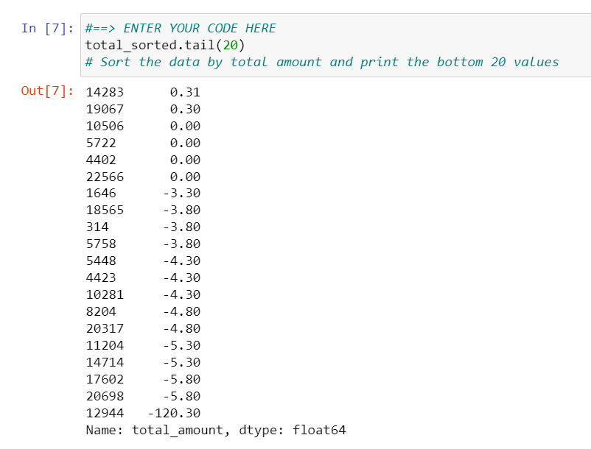
New York City TLC Project Preliminary Data Summary
Executive Summary Report
Project Overview
The New York City Taxi and Limousine Commission (TLC) contracted Automatidata to develop a regression model that helps estimate taxi fares before the ride. The Automatidata data team performed a preliminary data inspection.
This dataset includes variables that can be used to build prediction model
There are some unusual data when using sorted total amount variable (specifically in head and tail values)
Majority payment using credit card
Vendor proportion is roughly equal
Cash tip amount is 0, because it is not recorded
Image Alt-Text Here
Check validity for some unusual data
Conduct Exploratory Data Analysis (EDA)
Conduct descriptive analysis to understand the data further
Create and run a regression model

